Slide 1
Lesson: File
CSE 4107 : Structured Programming I
Shahriar Ivan

Slide 2
Streams
In C, the term stream means any source of input or any destination for output
Many small programs obtain all their input from one stream (the keyboard) and write all their output to another stream (the screen)
Larger programs may need additional streams
Streams often represent files stored on various media
However, they could just as easily be associated with devices such as network ports and printers

Slide 3
Streams
Standard Streams and Redirection
<stdio.h> provides three standard streams:
File Pointer Stream Default Meaning
stdin Standard input Keyboard
stdout Standard output Screen
stderr Standard error Screen
These streams are ready to use—we don’t declare them, and we don’t open or close them

Slide 4
Streams
Standard Streams and Redirection
The I/O functions discussed in previous chapters obtain input from stdin and send output to stdout
Many operating systems allow these default meanings to be changed via a mechanism known as redirection

Slide 5
Streams
Standard Streams and Redirection
A typical technique for forcing a program to obtain its input from a file instead of from the keyboard:
demo <in.dat // Input redirection
This technique is known as input redirection
Output redirection is similar:
demo >out.dat // Output redirection
All data written to stdout will now go into the out.dat file instead of appearing on the screen

Slide 6
Streams
Standard Streams and Redirection
Input redirection and output redirection can be combined:
demo <in.dat >out.dat // combined
The < and > characters don’t have to be adjacent to file names, and the order in which the redirected files are listed doesn’t matter:
demo < in.dat > out.dat
demo >out.dat <in.dat // shuffled

Slide 7
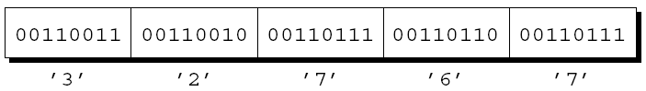
Streams
Text vs Binary Files
<stdio.h> supports two kinds of files: text and binary
Text File:
The bytes in a text file represent characters, allowing humans to examine or edit the file
The source code for a C program is stored in a text file
Ends with Carriage return (Windows only) + line feed
May contain an end of file marker
Can be stored as either text or binary form, for example,

Slide 8

Streams
Text vs Binary Files
<stdio.h> supports two kinds of files: text and binary
Binary File:
The other option is to store the number in binary, which would take as few as two bytes:
Storing numbers in binary can often save space

Slide 9
File Operations
Opening a File
Opening a file for use as a stream requires a call of the fopen function
Prototype for fopen:
FILE *fopen(const char * filename,
const char * mode);
filename is the name of the file to be opened
– This argument may include information about the file’s location, such as a drive specifier or path
mode is a “mode string” that specifies what operations we intend to perform on the file

Slide 10
File Operations
Opening a File
In Windows, be careful when file name in a call of fopen includes the ‘\’
The call
fopen("c:\project\test1.dat", "r")
will fail, because \t is treated as a character escape
One way to avoid the problem is to use \\ instead of \:
fopen("c:\\project\\test1.dat", "r")
An alternative is to use the / character instead of \:
fopen("c:/project/test1.dat", "r")

Slide 11
File Operations
Opening a File
fopen returns a file pointer that the program can (and usually will) save in a variable:
fp = fopen("in.dat", "r");
/* opens in.dat for reading */
When it can’t open a file, fopen returns a null pointer

Slide 12
File Operations
Modes
Mode strings for text files:
String Meaning
"r" Open for reading
"w" Open for writing (file need not exist)
"a" Open for appending (file need not exist)
"r+" Open for reading and writing, starting at beginning
"w+" Open for reading and writing (truncate if file exists)
"a+" Open for reading and writing (append if file exists)

Slide 13
File Operations
Modes
Mode strings for binary files:
String Meaning
"rb" Open for reading
"wb" Open for writing (file need not exist)
"ab" Open for appending (file need not exist)
"r+b" or "rb+" Open for reading and writing, starting at beginning
"w+b" or "wb+" Open for reading and writing (truncate if file exists)
"a+b" or "ab+" Open for reading and writing (append if file exists)

Slide 14
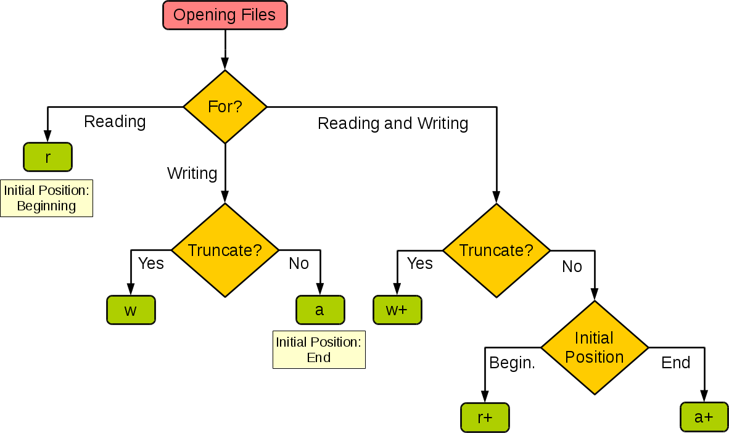
File Operations
Modes

Slide 15
File Operations
Modes
“write” mode ⇒ Normally overwrites the previous data
“append” mode ⇒ Adds at the end of the file
Rules for “read” + “write” ⇒
Can’t switch from reading to writing without positioning cursor
⇒ file-positioning function
⇒ Exception: Reading encountered EOF
Can’t switch from writing to reading without fflush or cursor positioning

Slide 16
File Operations
Closing a File
The fclose function allows a program to close a file that it’s no longer using
The argument to fclose must be a file pointer obtained from a call of fopen or freopen
fclose returns zero if the file was closed successfully
Otherwise, it returns the error code EOF (a macro defined in <stdio.h>)

Slide 17
File Operations
Attaching a File to an Open Stream
It’s not unusual to see the call of fopen combined with the declaration of fp:
FILE *fp = fopen(FILE_NAME, "r");
or the test against NULL:
if ((fp = fopen(FILE_NAME, "r")) == NULL) …

Slide 18
File Operations
Attaching a File to an Open Stream
freopen attaches a different file to a stream that’s already open
The most common use of freopen is to associate a file with one of the standard streams (stdin, stdout, or stderr)
A call of freopen that causes a program to begin writing to the file foo:
if (freopen("foo", "w", stdout) == NULL) {
/* error; foo can't be opened */
} // C99 can change mode upon failure

Slide 19
File Operations
Miscellaneous Operations
remove ⇒ Deletes a file
remove("foo"); // deletes the file named "foo"
rename ⇒ Changes file name
rename("foo", "bar");
– Handy for renaming a temporary file if needed
Both functions
Work with file names, not file pointers
Return zero if succeeded, return nonzero if failed
Make sure the files are closed

Slide 20
File I/O
The fprintf Function
Writes to the stream indicated by its first argument
fprintf(fp, "Total: %d\n", total); // writes to fp
fprintf(stdout, "Total: %d\n", total); // writes to stdout
Common use: write error messages ⇒ Guaranteed to appear
on screen
fprintf(stderr, "Error: data file can’t be opened.\n");
Returns the number of characters printed
– Returns negative value if error occurs

Slide 21
File I/O
The fscanf Function
Reads from the stream indicated by its first argument
fscanf(fp, "%d", &total); // reads from fp
fscanf(stdin, "%d", &total); // reads from stdin
Returns prematurely if
– Read error occurs ⇒ Detected by ferror()
– End-of-file (Input failure) occurs ⇒ Detected by feof()
– Matching failure occurs

Slide 22
File I/O
The fscanf Function
Detecting End-of-File and Error Conditions
– feof(fp) ⇒ Returns a nonzero value if end-of-file indicator is set
– ferror(fp) ⇒ Returns a nonzero value if error indicator is set

Slide 23
File I/O
Character I/O
Write character to an arbitrary stream
fputc(ch, fp); // writes ch to fp
Read character from an arbitrary stream
ch = fgetc(fp); // reads ch from fp

Slide 24
File I/O
Character I/O
Always test EOF against int
To push back a character to the stream:
while (isdigit(ch = getc(fp))){
...
}
ungetc(ch, fp); // pushes back last character read

Slide 25
File I/O
Line I/O
Write single line to any stream
fputs("Hello there, General Kenobi!", fp);
Doesn’t write new-line ⇒ Unlike puts
Read fixed number of characters
fgets(str, sizeof(str), fp);
– Reads until the first new-line character or sizeof(str) - 1 characters at most
– Stores the new-line character if read

Slide 26
File I/O
Block I/O
Copy array from memory to stream which takes:
– Address of array, Size of each array elements in bytes
– Number of elements to write, File Pointer
fwrite writes from memory to stream and returns the number of elements written
fwrite(a, sizeof(a[0]), sizeof(a) / sizeof(a[0]), fp);
fread reads array from stream and returns number of elements read
fread(a, sizeof(a[0]), sizeof(a) / sizeof(a[0]), fp);

Slide 27
File I/O
Block I/O
Every stream has an associated file position
When a file is opened, the file position is set at the beginning of the file
– In “append” mode, the initial file position may be at the beginning or end, depending on the implementation
When a read or write operation is performed, the file position advances automatically, which helps with sequential access of data
<stdio.h> provides five functions that allow a program to determine the current file position or to change it

Slide 28
File I/O
The fseek Function
Changes the file position associated with a file pointer
Requires three arguments ⇒
First argument ⇒ file pointer
Second argument ⇒ Byte count (long int)
Third argument ⇒ Macro
SEEK_SET Beginning of file
SEEK_CUR Current file position
SEEK_END End of file

Slide 29
File I/O
The fseek Function
Using fseek to move to the beginning of a file:
fseek(fp, 0L, SEEK_SET);
Using fseek to move to the end of a file:
fseek(fp, 0L, SEEK_END);
Using fseek to move back 10 bytes:
fseek(fp, -10L, SEEK_CUR);
If an error occurs (the requested position doesn’t exist, for example), fseek returns a nonzero value

Slide 30
File I/O
The ftell Function
The ftell function returns the current file position as a long integer
The value returned by ftell may be saved and later supplied to a call of fseek:
long file_pos;
…
file_pos = ftell(fp); /* saves current position */
…
fseek(fp, file_pos, SEEK_SET); /* returns to old position */

Slide 31
File I/O
The ftell Function
If fp is a binary stream, the call ftell(fp) returns the current file position as a byte count, where zero represents the beginning of the file
If fp is a text stream, ftell(fp) isn’t necessarily a byte count
As a result, it’s best not to perform arithmetic on values returned by ftell

